Slide 1
‘Being loved into life’
St Peter’s Ruddington
Lent Course 2025

Slide 2
Session 5: Living in the Spirit.

Slide 3
Being loved into life: Lent 25
Session 1: Scope and work of the Holy Spirit.
Session 2: Role of the Holy Spirit in Prayer.
Session 3: Lament
Session 4: Improving our Prayer life
– the Examen.
Session 5: Living by the Spirit
– how do we live this going forward?

Slide 4
What is holier? Praying or serving others?

Slide 5
Two models of Spirituality:
Scriptural Model: Self-in-God
Father Son
Human Spirit
Grace
Holy Spirit
Body Mind
God initiates: Self responds

Slide 6
Formal prayer: the time that we formally withdraw from activity to express our relationship with the Lord.
Service: all of the activities that we perform outside of our prayer time to fulfil God’s will in our life; which included our daily work as well as all other activities done in tune with the Holy Spirit

Slide 7
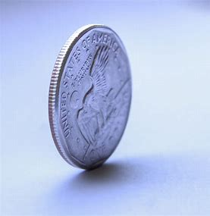
Prayer and service: interconnected parts of the same life.
Prayer
Service

Slide 8
Formal prayer supports service: in the life of Jesus.
Before the beginning of his public ministry.
Before the sermon on the mount.
Before choosing the 12 disciples.
Before leaving Galilee and journeying towards Jerusalem.
In the garden of Gethsemane before his arrest.

Slide 9
Service supports formal prayer
‘Service’ is the time when the Holy Spirit accompanies us
Apprentices us.
Equips us,
Inspires us,
Empowers us
Accomplishes, through us, what God wants to achieve on this earth!

Slide 10
¹⁵ I do not understand what I do. For what I want to do I do not do, but what I hate I do. ¹⁶ And if I do what I do not want to do, I agree that the law is good. ¹⁷ As it is, it is no longer I myself who do it, but it is sin living in me. ¹⁸ For I know that good itself does not dwell in me, that is, in my sinful nature. For I have the desire to do what is good, but I cannot carry it out. ¹⁹ For I do not do the good I want to do, but the evil I do not want to do—this I keep on doing. ²⁰ Now if I do what I do not want to do, it is no longer I who do it, but it is sin living in me that does it.

Slide 11
²⁴ What a wretched man I am! Who will rescue me from this body that is subject to death? ²⁵ Thanks be to God, who delivers me through Jesus Christ our Lord!
Romans 7:15-20,24-25

Slide 12
Intentionally noticing God the Holy Spirit at work is going to take all of us:
Body, mind and spirit.

Slide 13
Body
How might exercise help?
What about our sleep?
How much do we eat and drink?
“Don’t drink too much wine. That cheapens your life. Drink the Spirit of God, huge drafts of him.” (Eph. 5:18)

Slide 14
Minds
‘You are what you eat’? You are what you think, what we watch and what we read?
When do we give our minds a rest?
How do we keep our minds sharp, alert to the presence of God?

Slide 15
Spirit
Daily prayer
Regular bible study.
Weekly gathering as church (big on Sunday and small with your homegroups)
The Examen.
  Give thanksgiving.
  Ask the Holy Spirit
  Review and recognise your failures.
  Ask for forgiveness and healing.
  Pray about the next day.

Slide 16
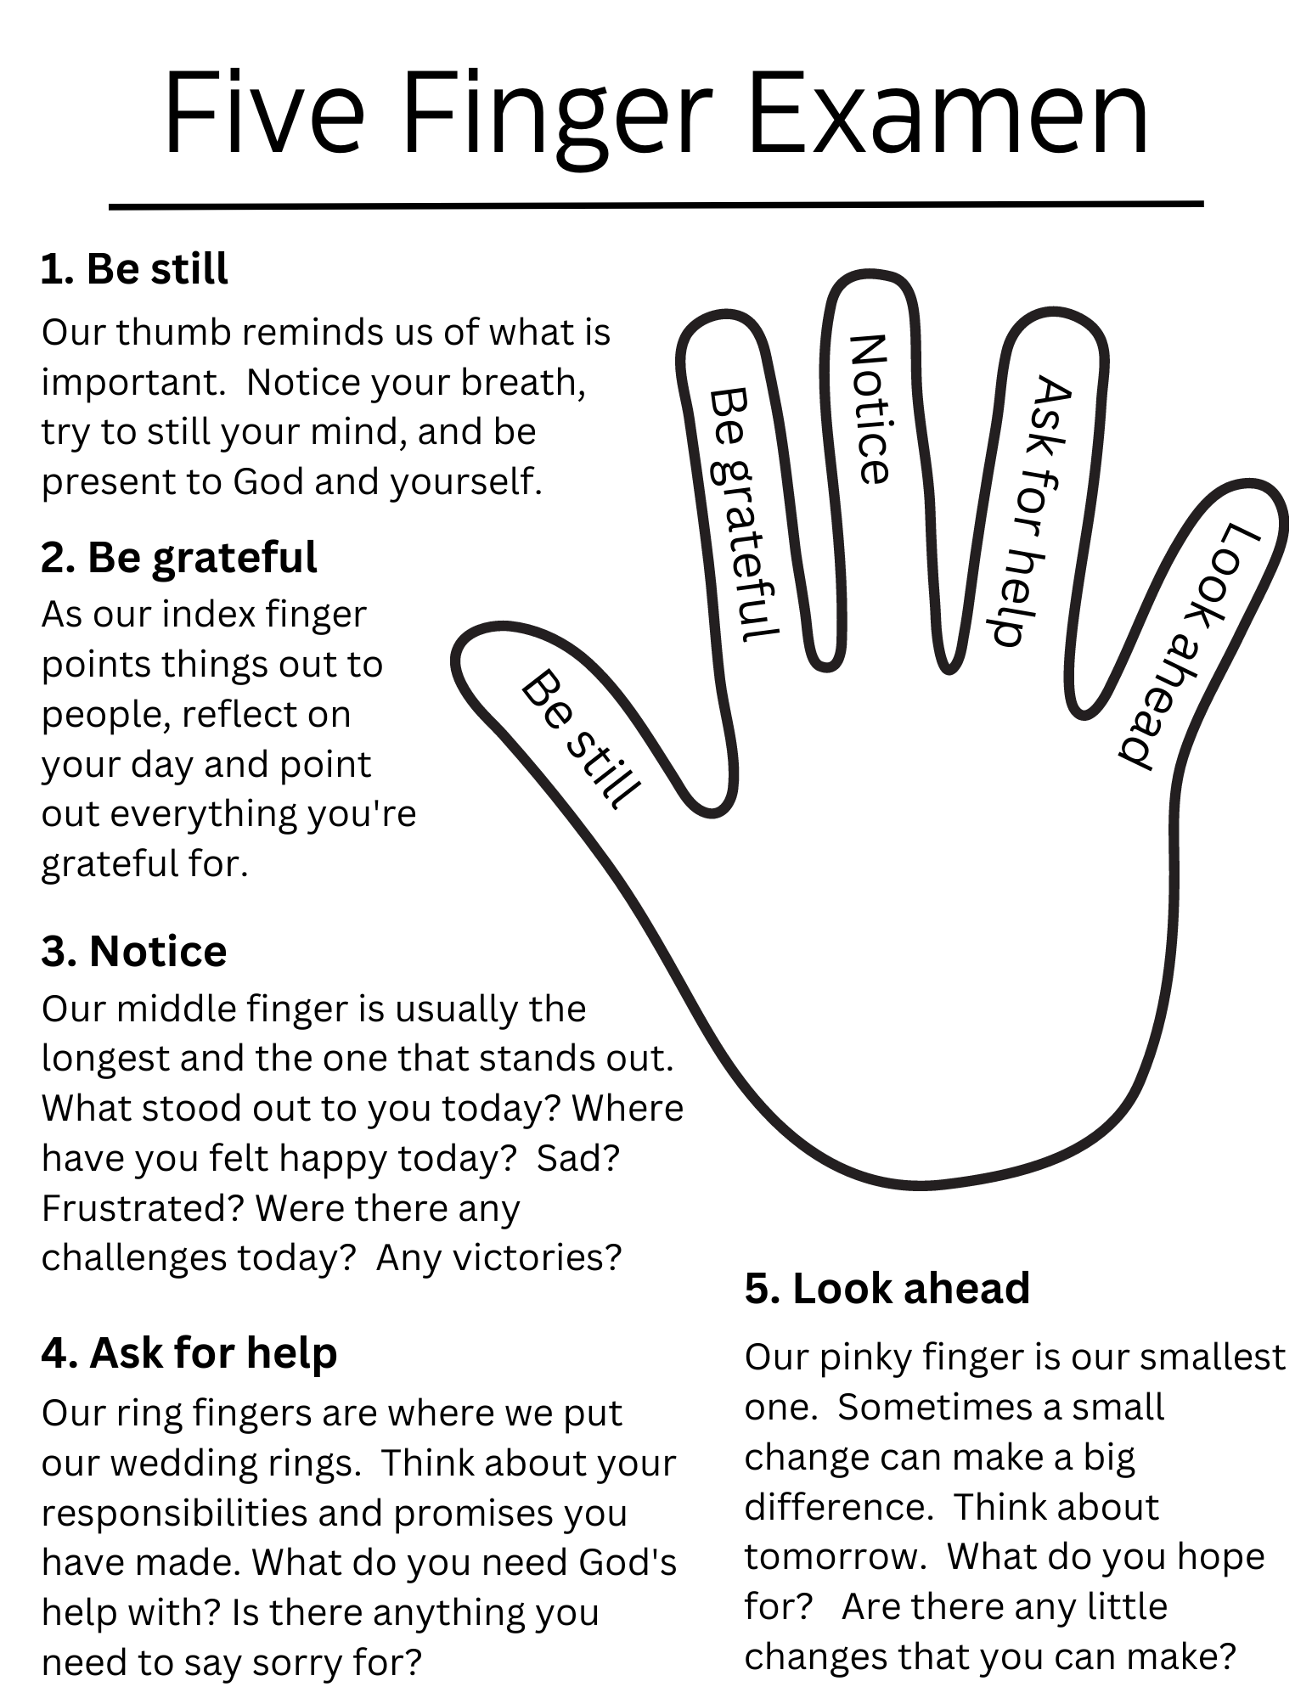

Slide 17
‘One life in Christ’:
The goal of the spiritual life is to allow the Spirit of Christ to influence all our activity, prayer as well as service. Our role in this process is to provide conditions in our lives to enable us to live in tune with his Spirit. Our effort is not a self-conscious striving to fill ourselves with important Christian virtues; it is more getting out of the way and allowing his spirit to transform all our activities. Christ will do the rest.

Slide 18
His Spirit has joined ours and will never abandon us. Gradually, we become more and more sensitive to the movements of this of Christ spirit in our own hearts; simultaneously we grow in sensitivity to the movement of his spirit in others. Subtly our vision of the world changes. We begin seeing everything in relationship to Christ and the Father, and so we carry on a continual dialogue with them. Without really trying, we find ourselves for fulfilling Paul’s injunction to the Ephesians to “Pray always.”
Father Richard J Hauser SJ

Slide 19
Small group discussion
Much of what Andrew has talk about is around helpful rhythms and practices. Share with each other what have you found useful in the past and what you might try to establish.
How linked have your prayer and service been in the past? How might you strengthen this relationship?
Do you see how everything (body, mind and spirit) links together to form one life in Christ? Why do we find it easy to compartmentalise areas of our life?

